Slide 1
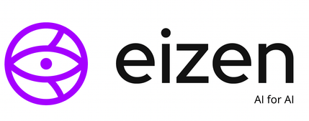
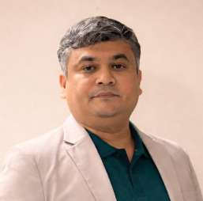




Dr. Madan Dabbeeru
Founder eizen.ai
USA, Dubai, Bangalore
With over 22 years of AI research and engineering, Dr. Madan has built systems that operate at the intersection of science, scale, and real-world impact. He has led AI initiatives at Rakuten India as Head of Research, and was a key architect at unicorn startup Phenom People — delivering AI across Defense, Healthcare, Banking, and E-Commerce. His work includes Unmanned Vehicles for the US Navy and Air Force, AI for cancer research, and perhaps most fascinatingly, building AI that generates AI. He holds a Post-Doc & PhD in Cognitive Robotics from the University of Maryland, IIT Kanpur, and BITS Pilani.
Dr. Madan Dabbeeru

Slide 2
Title: Evolving the Watchers: Verifier-Driven Perpetual Learning for Robot Observability
Abstract
As robots move from controlled pilots to fleet-scale deployments in manufacturing and logistics, a new problem emerges: how do we reliably know whether a robot is performing as intended? Robot telemetry reports what the machine believes it did. It often misses slow degradation, subtle grasp failures, timing drift, and deviations from standard operating procedures. Observer models trained once and deployed statically decay as sites, robot models, and products change. This talk presents how Eizen AI approaches robot observability as a continuous engineering discipline, which we call RobOps, built on a dual-vision approach that pairs the robot's own ego-view with an external exo-view of the work being done. We describe a perpetual learning loop in which observer models are not hand-tuned but evolved. Inside a simulated robot environment with controllable fault injection, evolutionary algorithms co-evolve two populations: increasingly challenging failure scenarios, and a diverse archive of observer models that learn to detect them. Fitness is not a single gameable reward. It is determined by a panel of independent verifiers: simulation ground truth, physical and kinematic consistency, cross-view agreement, formal checks of procedure compliance, and confidence calibration. Disagreement among verifiers on real-world data becomes the signal that drives the next cycle of learning. We close with open research challenges, including correlated verifier blind spots, the sim-to-real gap in failure modelling, and the cost of open-ended search, along with opportunities for student research and collaboration.
Dr. Madan Dabbeeru

